Slide 1

Lecture 4: Reflection & XML
WRPV301: Advanced Programming
Dr Simone Beets

Slide 2
Some admin…

Slide 3
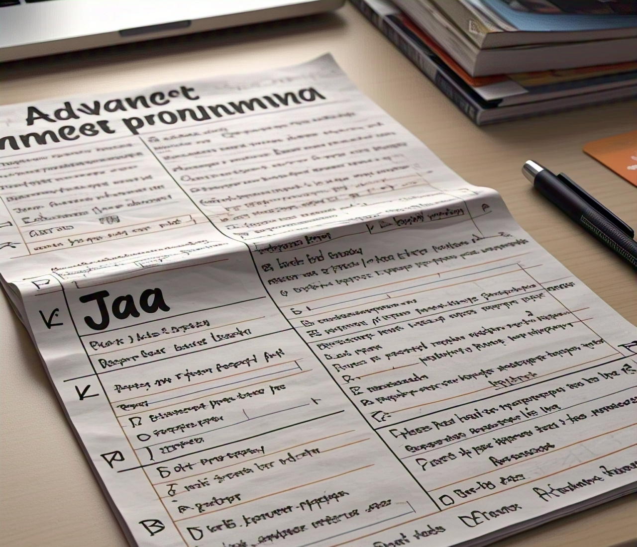
Upcoming test
Not final
Needs to be moderated, so can change but will confirm
About 30% theory, 10% applied answers, 60% practical
Need to prep all content including today’s work
Cheat sheet only allowed for practical section
3 hours
Start at 09:00, Saturday 14 March 2025, Labs 3 & 4
Notes:
Send me concession letters asap by end of today

Slide 4

Reflection

Slide 5
What is it?
Class object
Field object
Method object
Reflection

Slide 6

What is reflection?
Classes, methods, fields, interfaces, etc. can be inspected & manipulated from code at run-time
So: you can write Java code to ask some unknown object what methods or fields it has & you can then call these methods, the get/set values of fields, etc.
Notes:
Classes, methods, fields, interfaces, etc. can be inspected & manipulated from code at run-time
So: you can write Java code to ask some unknown object what methods or fields it has & you can then call these methods, the get/set values of fields, etc.

Slide 7
Why is reflection useful?
Allows automagic saving & loading of objects, e.g., to/from XML, database, …
Allows the connections (objects & methods) between objects to be loaded/saved, e.g., user interfaces (UIs) & events
Allows an existing application to use code it was not compiled with to function together
Allows IDEs (such as IntelliJ) to create &/ set values for objects (e.g., UI objects, database connections, …) without having to know about them up front
Notes:
Allows automagic saving & loading of objects, e.g., to/from XML, database, …
Allows the connections (objects & methods) between objects to be loaded/saved, e.g., user interfaces (UIs) & events
Allows an existing application to use code it was not compiled with to function together
Allows IDEs (such as IntelliJ) to create &/ set values for objects (e.g., UI objects, database connections, …) without having to know about them up front
Where/how used (from Oracle docs):
Extensibility Features
An application may make use of external, user-defined classes by creating instances of extensibility objects using their fully-qualified names.
Class Browsers and Visual Development Environments
A class browser needs to be able to enumerate the members of classes. Visual development environments can benefit from making use of type information available in reflection to aid the developer in writing correct code.
Debuggers and Test Tools
Debuggers need to be able to examine private members on classes. Test harnesses can make use of reflection to systematically call a discoverable set APIs defined on a class, to insure a high level of code coverage in a test suite.

Slide 8
The Class Object
Concept
Each object & class has a Class object
Allows for introspection & runtime manipulation
From an object
obj.getClass()
How to obtain a Class object?
Directly from a class
SomeClass.class
Using the class’s name
Class.forName(fullName)
What information is provided?
Fields
Methods
Superclass extended
Implemented interfaces
Applied annotations
See /example01

Slide 9
The Field Object
Concept
Provides details about a field & allows manipulation
Public fields
Class.getField(name) or Class.getFields()
How to obtain a Field object?
Private or protected fields
Class.getDeclaredField(name) or Class.getDeclaredFields()
Considerations
Should not manipulate private or protected fields (but is possible)
Generally, object fields (vs primitive types) are easier to work with
getDeclared* methods only look at the current class, i.e., those declared in the class, not those inherited
See /example02
Notes:
Considerations:
Should not manipulate private or protected fields (but is possible)
Generally, object fields (vs primitive types) are easier to work with. Need to be careful with primitives
getDeclared* methods only look at the current class, i.e., those declared in the class, not those inherited

Slide 10
The Method Object
Concept
Provides details about a method & allows manipulation
Using…
Its name, or
Using name & parameter types (if there are multiple overloaded versions of a method)
How to obtain a Method object?
Example
getMethod
How to execute/run a method?
Using its invoke method, passing
Object to be run on (or null if a static method) &
Parameter values
See /example03

Slide 11
Other items that can be obtained
Some information about generics
Some information about primitive arrays
Annotations
Constructors
Notes:
What are annotations?
Special types of metadata that provide more information about code
They provide data to compiler or runtime env.
Can be applied to classes, methods, fields, etc.
@ symbol prefix
E.g., @Override, @Deprecated, @SuppressWarnings

Slide 12
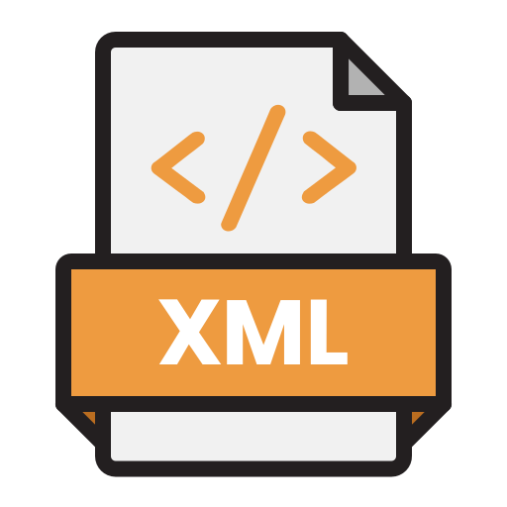
XML

Slide 13
Why XML?
What is XML?
XML structure
Parsing XML documents (XPath)
Creating XML documents
Other XML technologies
XML

Slide 14

Why XML?
String
Toaster
29.95
Number
Structured
Unambiguous
Readable
<product>
<description>Toaster</description>
<price>29.95</price>
</product>

Slide 15
Why XML?
Toaster
29.95
LG
<product>
<make>LG</make>
<description>Toaster</description>
<price>29.95</price>
</product>
Notes:
Modifications?
You can define & update information in a structured way
So we know that LG is the make or brand & we can add that to the product object
Doesn’t disrupt the existing structure
Ensure that each element has the correct relationship → <make> will always have the brand/make

Slide 16
What is XML?
XML → Extensible Markup Language
Is not HTML! (HTML is a subset of XML)
Text-based technology for transferring data
Uses elements that are tagged
Tags can have attributes
Self describing
Can validate document structure
Can query document

Slide 17
XML structure
An XML document consists of:
Declaration (info about format used)
Root element
Elements
<element>…</element> (start and closing tag)
<element /> (self-closing tag)
Contain
Other elements, text or (elements & text) i.e., nested
Good practice: only elements or text, not both
Attributes: <element a1=“value” a2=“value” …>…

Slide 18
XML structure
Root
<product>
<name>Toaster</name>
<price>29.95</price>
<make>LG</make>
<category>Kitchen</category>
</product>
Child elements
Text content

Slide 19
<?xml version=“1.0”?>
<products>
<product>
<description>Toaster</description>
<price currency=“USD”>29.92</price>
<category>Appliances</category>
</product>
<product>
<description>Lawn Mower</description>
<price currency=“EUR”>100.10</price>
<category>Garden</category>
</product
</products>
Notes:
XML declaration on first line (info about the document itself, i.e., version & encoding)
Not an element → declaration

Slide 20
Parsing XML documents
Parser required to analyse an XML document
Streaming parsers
Receive one tag at a time & must process document yourself
Useful if have massive data sets (i.e., Big Data)
Tree-based parser
Document Object Model (DOM)
Implemented in DocumentBuilder class
Query a built Document object using XPath
Useful for smaller data sets that you would like to query as a whole
Notes:
For the tree-based parser:
Reads in an XML document & builds a hierarchical tree-like structure represented by the DOM
DOM: tree where a node represents an element, attribute or text in the XML document

Slide 21
XML example
/items/item[2]/quantity
/items/item[1]/product/price
items
item[1]
product
quantity
item[2]
product
quantity
description
price
description
price
4-port Mini Hub
19.95
10
Ink Jet Refill
29.95
8
items
item[1]
product
quantity
item[2]
product
quantity
description
price
description
price
4-port Mini Hub
19.95
10
Ink Jet Refill
29.95
8
items
item[1]
product
quantity
item[2]
product
quantity
description
price
description
price
4-port Mini Hub
19.95
10
Ink Jet Refill
29.95
8
<?xml version="1.0"?>
<items>
<item>
<product>
<description>Ink Jet Refill</description>
<price currency="ZAR">29.95</price>
</product>
<quantity>8</quantity>
</item>
<item>
<product>
<description>4-port Mini Hub</description>
<price currency="ZAR">19.95</price>
</product>
<quantity>10</quantity>
</item>
</items>

Slide 22
XPath
Refer to an element’s attribute
@attribute
E.g., /items/item[1]/product/price/@currency
Supports aggregate functions (perform operations on nodes)
count(/items/item)
count (/items/*)
Find name of child (if unknown)
name(/items/item[1]/*[1])
Notes:
XPath:
XML Path Language
Query language that is used to navigate and make selections in an XML document
Used to located data in these XML documents using XPath expressions

Slide 23
XPath example
/items/item[1]/product/price/@currency
<?xml version="1.0"?>
<items>
<item>
<product>
<description>Ink Jet Refill</description>
<price currency=“USD”>29.95</price>
</product>
<quantity>8</quantity>
</item>
<item>
<product>
<description>4-port Mini Hub</description>
<price currency=“ZAR”>19.95</price>
</product>
<quantity>10</quantity>
</item>
</items>
Notes:
Starts at 1 not 0

Slide 24
XPath example
count(/items/item)
count (/items/*)
<?xml version="1.0"?>
<items>
<item>
<product>
<description>Ink Jet Refill</description>
<price currency=“USD”>29.95</price>
</product>
<quantity>8</quantity>
</item>
<item>
<product>
<description>4-port Mini Hub</description>
<price currency=“ZAR”>19.95</price>
</product>
<quantity>10</quantity>
</item>
</items>

Slide 25
XPath example
name(/items/item[1]/*[1])
<?xml version="1.0"?>
<items>
<item>
<product>
<description>Ink Jet Refill</description>
<price currency=“USD”>29.95</price>
</product>
<quantity>8</quantity>
</item>
<item>
<product>
<description>4-port Mini Hub</description>
<price currency=“ZAR”>19.95</price>
</product>
<quantity>10</quantity>
</item>
</items>

Slide 26
XPath example
count(/items/item[2]/*)
<?xml version="1.0"?>
<items>
<item>
<product>
<description>Ink Jet Refill</description>
<price currency=“USD”>29.95</price>
</product>
<quantity>8</quantity>
</item>
<item>
<product>
<description>4-port Mini Hub</description>
<price currency=“ZAR”>19.95</price>
</product>
<quantity>10</quantity>
</item>
</items>

Slide 27
XPath
IntelliJ provides a useful tool to help test your XPath queries
Right-click on an open XML document and choose ‘Evaluate XPath…”
Much more functionality
Check http://www.w3.org/TR/xpath
See /example01

Slide 28
Traversing the document tree
Can traverse the tree manually
Each node:
Has 0 or more child nodes
Can be Element or TextNode
An element is a node, which has attributes, other elements &/ text nodes attached to it
A text node is simply a string
Even empty sides of node appear as TextNodes
See /example02

Slide 29
Creating XML documents
Use Document object
Build up tree one node at a time
Typically
have methods that know how to build a specific part of the XML document
e.g., a method called createItem that takes the fields (or object) for an item & creates an XML node (with attributes, child-nodes, etc.) representing it
See /example03

Slide 30
Other XML technologies
XSD (XML Schema Definition)
checks if XML document has the correct structure (schema)
simply provide a text file describing the structure (think WRL) & a file & you are told if the structure in the file matches the description
XSLT (Extensible Stylesheet Language Transformations)
transforms XML (and other text) documents to another format (text, XML, rtf, pdf, etc.)  (text, XML, rtf, pdf, etc.)
simply provide a text file that describes how to do the conversion, then give it the source file and the transformed file is created from it
Notes:
XSD
Define the structure, data types & constraints for your XML document
Checks if a provided XML document is valid when compared to the XSD
XSLT
Defines templates → how to transform your XML content using a stylesheet
Processes the provided document & generates the output

Slide 31
Other XML technologies
Name spaces
to allow different organisations to use the same element names
Tutorials at
http://download.oracle.com/javase/tutorial/jaxp/xslt/xpath.html
Notes:
Name spaces
Avoid naming conflicts (when combining XML documents from several sources)

Slide 32

Quick exercise…
Instructions:
In groups of 5 (add your names)
You can use any device that you have on you but also don’t forget about chatting to each other too!
You can use any electronic source available → note down what tools were used!
Use pen & paper & hand in

Slide 33

Class exercise
You have 10 minutes…
Give the XPath query and the answer.
What degree is the student registered for?
How many years has the student studied?
In 2002, what was the mark obtained for the June exams for WRA101?
How many exams were written for WRA101 (including supplementary exams)?
How many supplementary exams (for different modules) did the student write?
In 2003, what is the module code of the 2nd module enrolled for?

Slide 34
Assignments
Assignment 2:
Uploaded
Due - check the schedule
Task 1: Submit using GitHub
(Will be graded using automated tests)
Rest of the tasks via Funda

